Slide 1
Design Review 1
Team 8
Ze An
Priyanka Anantha
De-Wei Chang
Andria Nyenhuis
Tong Shen

Slide 2
Function Decomposition
Function decomposition leads to identifying robot attributes
Identify ball
Move to ball
Collect ball
Identify container door
Close container door
Dispense ball
Open container door
Move to container

Slide 3
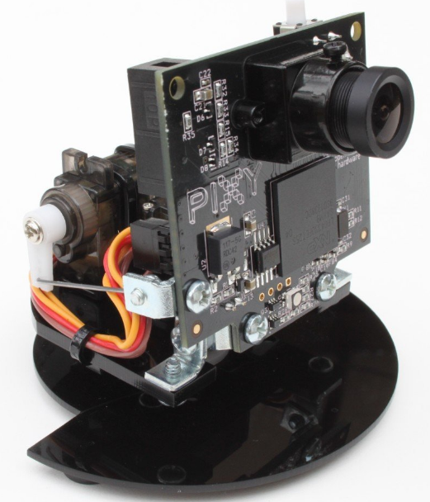
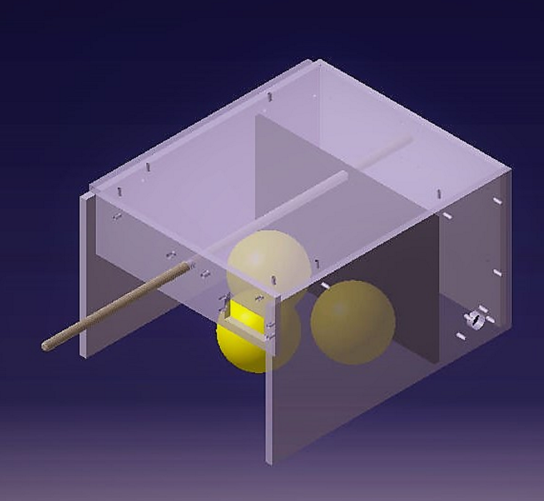
Design Overview
Ball identification
Pixy Smart Vision Detection
Move to ball
Rear wheel drive, 2x 12V DC motors with 43.7:1 gear box
Direction control : encoders and Pixy feedback
Ball collection
Chassis trap container
Servo motor driven door mechanism
Container door identification
Pixy Smart Vision Detection
Container door open
Ball dispensing
Push plate driven by DC motor coupled to lead screw
Container door close

Slide 4
Subsystem Break Down
Controls
Electronics
Mechanical
ball tracking
motors
FSM
sensors
motors
driver
batteries
microcontroller
chassis
push plate
trap door
wheels
wheel mount
motor mounts
lead screw assembly

Slide 5
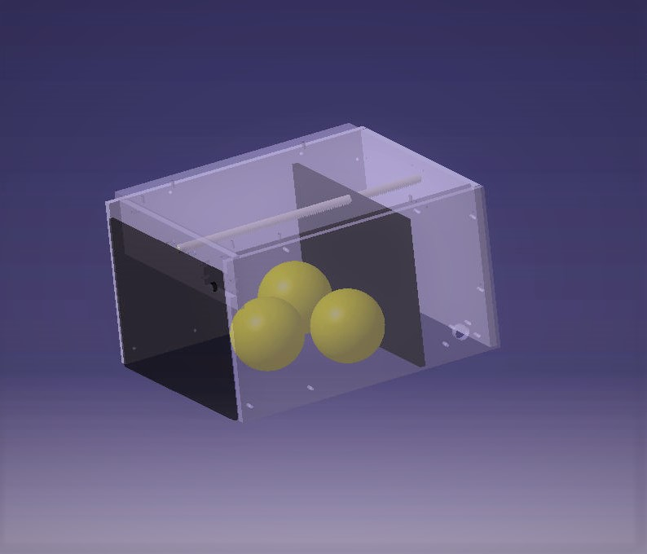
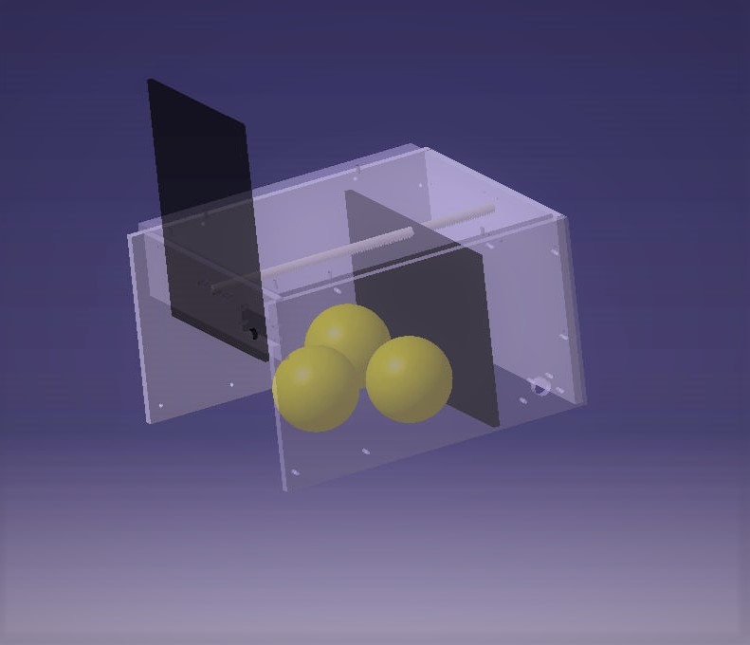
Mechanical Subsystem
Door Closed
Door Open

Slide 6
Mechanical Subsystem
Component Requirements
Chassis
structural
resistant to vibrations
easy to process
easy to assemble
Push Plate
light weight
rigid
Trap Door
light weight
rigid
Wheels
tall
Traction
minimal start up torque
Component Mounts
rigid
secure method to chassis
Lead Screw Assembly
robust to misalignment

Slide 7
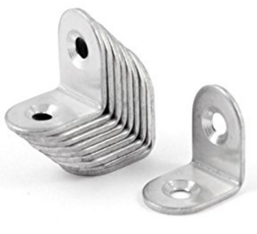
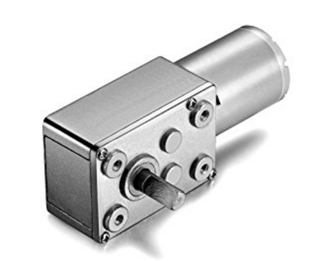
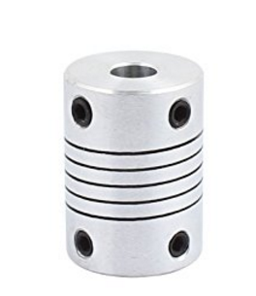
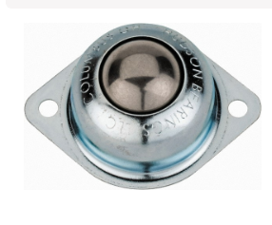
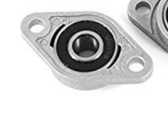
Mechanical Subsystem
Component Selection
Chassis
laser cut acrylic sheets
joined with corner brackets and M3 bolts
Push Plate
reinforced cardboard
Trap Door
reinforced cardboard
Wheels
Front : metal ball casters
Back : TBD
Component Mounts
corner brackets and direct mounts
Lead Screw Assembly
robust to motor coupling misalignment
DC motor with worm gear

Slide 8
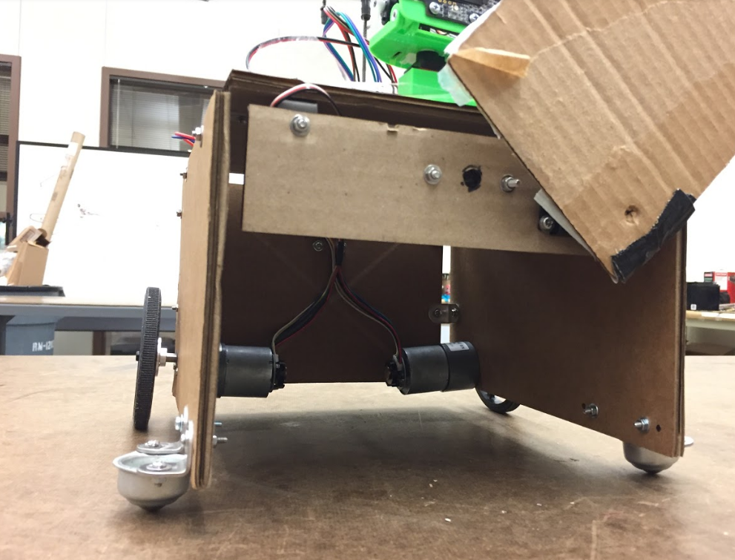
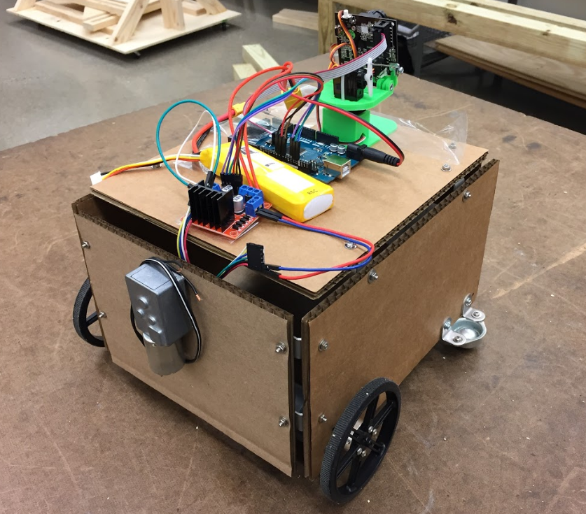
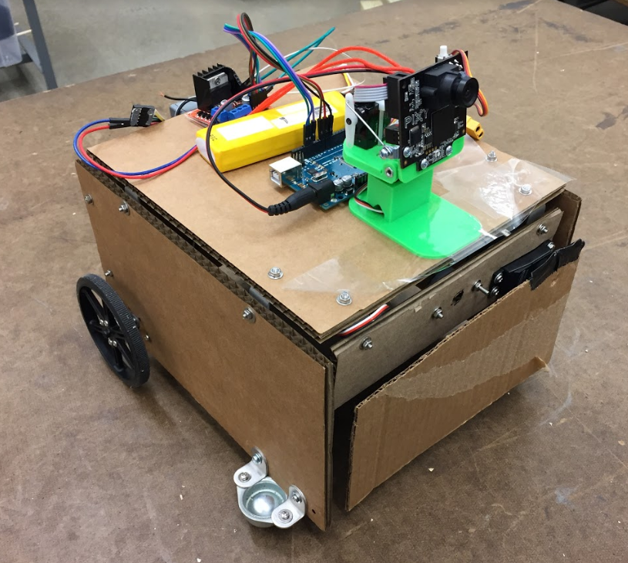
Mechanical Subsystem
Prototype

Slide 9
THANK YOU

